Slide 1
Advanced SQL Insights: Analyzing the IMDB Movie Dataset
Aswin Raj V.P

Slide 2
Introduction
Objective of the Project:
Reinforce SQL concepts
Joins
Aggregation
Filtering,
Grouping).
Analyze real-world data to extract meaningful insights.

Slide 3
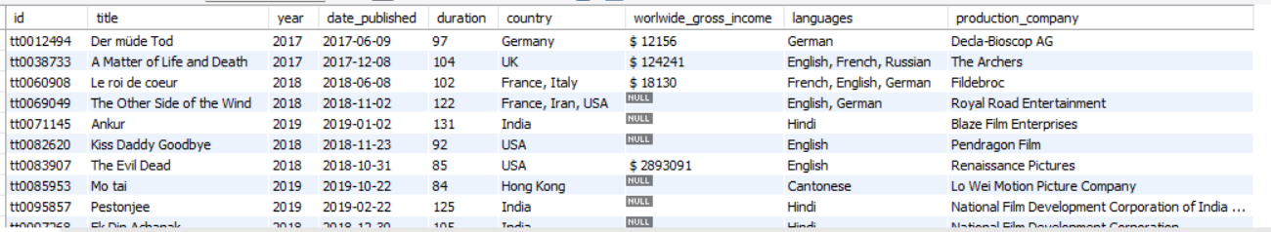
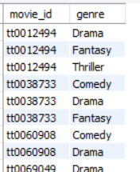
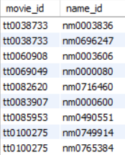
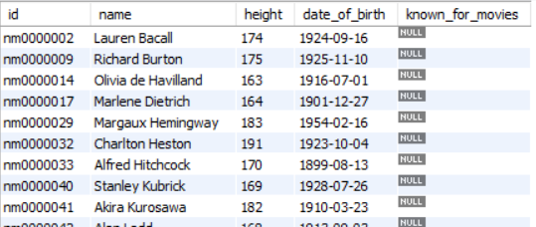
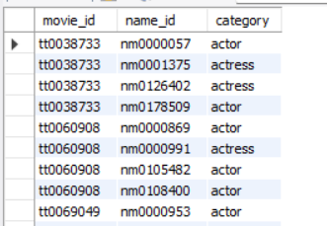
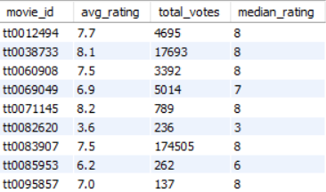
Tables
Movies
Genre
Director_mapping
Names
Role_mapping
Ratings

Slide 4
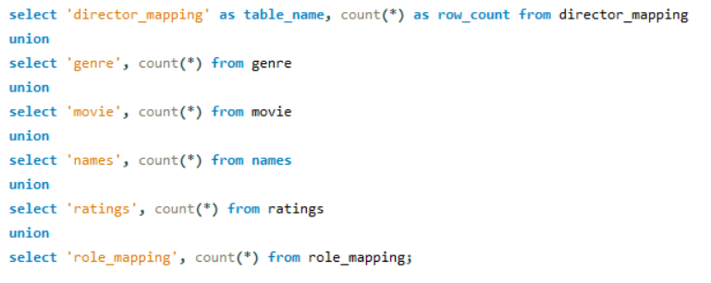
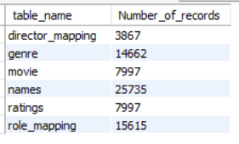
1.Count the total number of records in each table of the database.
Input:
Output:

Slide 5
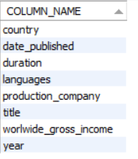
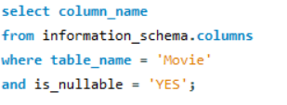
2. Identify which columns in the movie table contain null values.
Input:
Output:

Slide 6
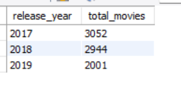

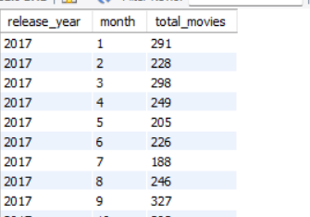
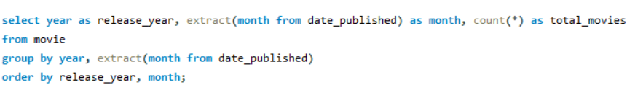
3. Determine the total number of movies released each year, and analyze how the trend changes month-wise.
Input:
Output:
Output:
Input:

Slide 7
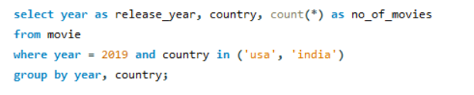

4. How many movies were produced in either the USA or India in the year 2019?
Input:
Output:

Slide 8
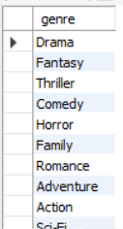

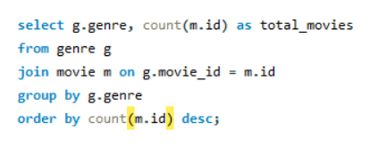
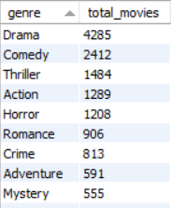
5. List the unique genres in the dataset, and count how many movies belong exclusively to one genre.
Input:
Output:
Input:
Output:

Slide 9
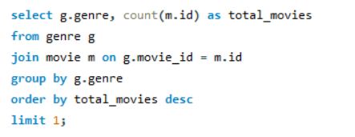

6. Which genre has the highest total number of movies produced?
Input:
Output:

Slide 10
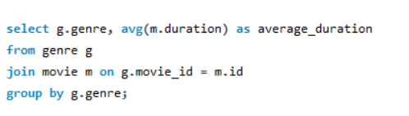
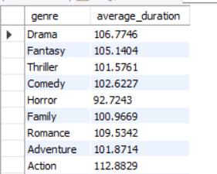
7. Calculate the average movie duration for each genre.
Input:
Output:

Slide 11
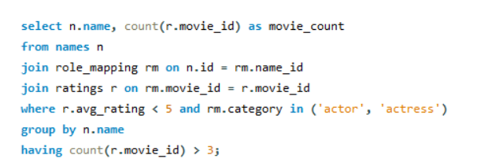
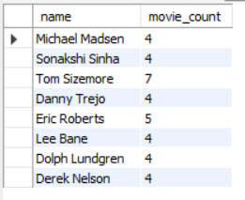
8. Identify actors or actresses who have appeared in more than three movies with an average rating below 5.
Input:
Output:

Slide 12



9. Find the minimum and maximum values for each column in the ratings table, excluding the movie_id column.
Input:
Output:
Input:
Output:
Input:
Output:

Slide 13
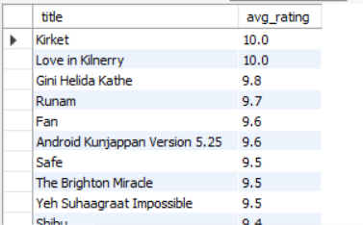
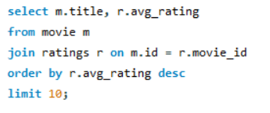
10. Which are the top 10 movies based on their average rating?
Output:
Input:

Slide 14
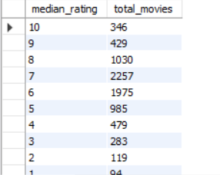
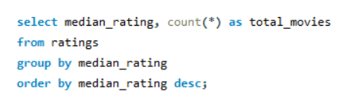
11. Summarize the ratings table by grouping movies based on their median ratings
Input:
Output:

Slide 15
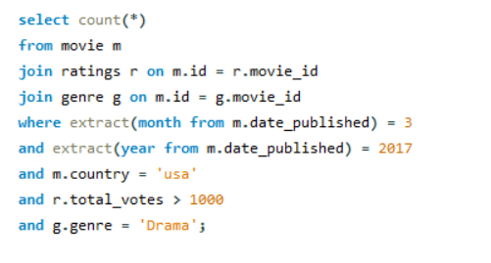

12. How many movies, released in March 2017 in the USA within a specific genre, had more than 1,000 votes?
Input:
Output:

Slide 16
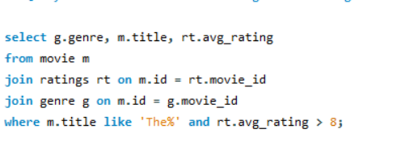
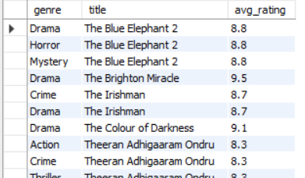
13. Find movies from each genre that begin with the word “The” and have an average rating greater than 8.
Input:
Output:

Slide 17

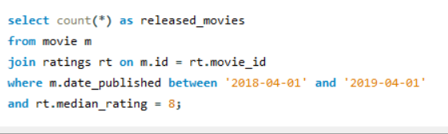
14. Of the movies released between April 1, 2018, and April 1, 2019, how many received a median rating of 8?
Input:
Output:

Slide 18
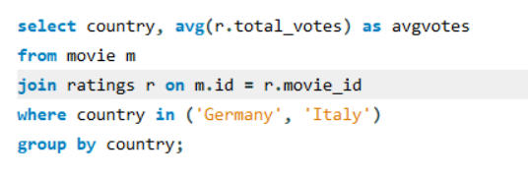

15. Do German movies receive more votes on average than Italian movies?
Input:
Output:

Slide 19
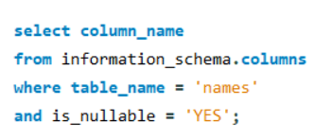
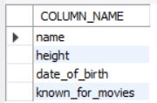
16. Identify the columns in the names table that contain null values.
Input:
Output:

Slide 20
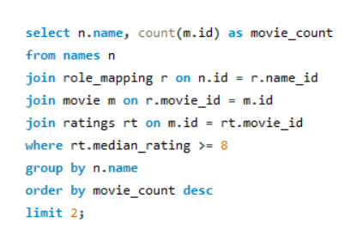
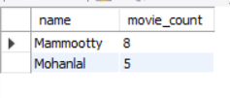
17. Who are the top two actors whose movies have a median rating of 8 or higher?
Input:
Output:

Slide 21
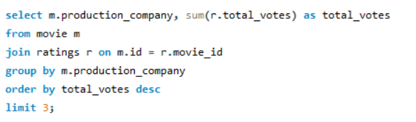
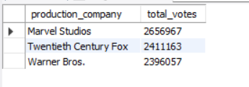
18. Which are the top three production companies based on the total number of votes their movies received?
Input:
Output:

Slide 22
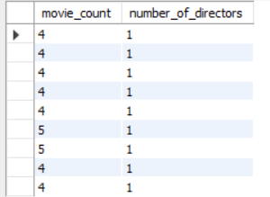
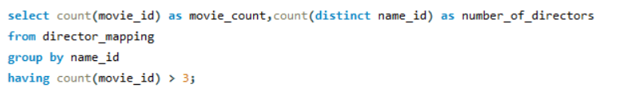
19. How many directors have worked on more than three movies?
Input:
Output:

Slide 23
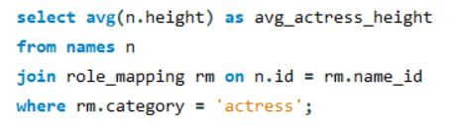

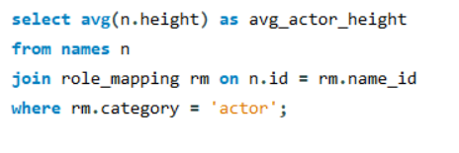

20. Calculate the average height of actors and actresses separately.
Input:
Output:
Input:
Output:

Slide 24
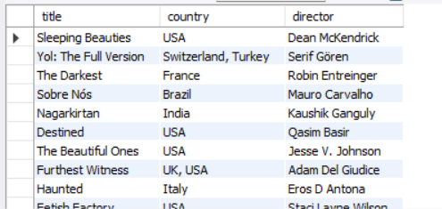
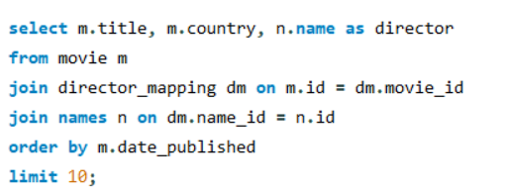
21. List the 10 oldest movies in the dataset along with their title, country, and director.
Output:
Input:

Slide 25
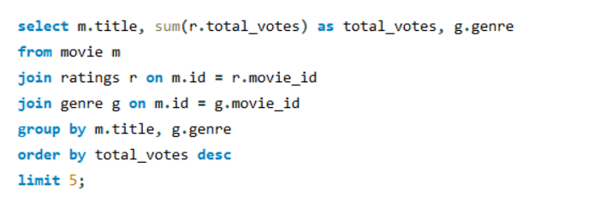
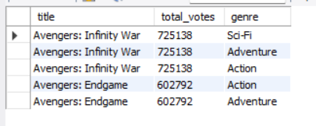
22. List the top 5 movies with the highest total votes, along with their genres.
Input:
Output:

Slide 26
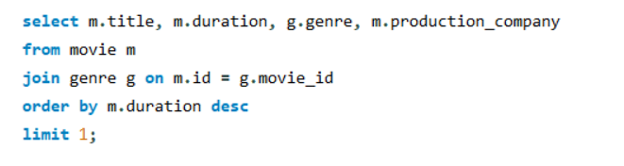

23. Identify the movie with the longest duration, along with its genre and production company.
Input:
Output:

Slide 27
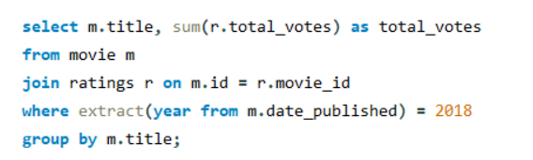
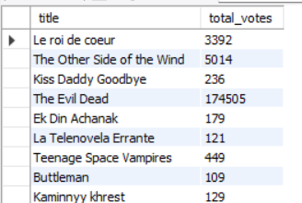
24. Determine the total number of votes for each movie released in 2018.
Input:
Output:

Slide 28
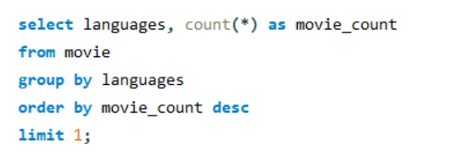

25. What is the most common language in which movies were produced?
Input:
Output:

Slide 29
Conclusions & Insights
Genres: Drama is most frequent. Action is longest.
Trends: Movie releases dropped from 2017 to 2019.
Actors: Mammootty and Mohanlal star in top-rated movies.
Avengers: Avengers movies dominate with the highest votes.

Slide 30
Thank you

